Slide 1
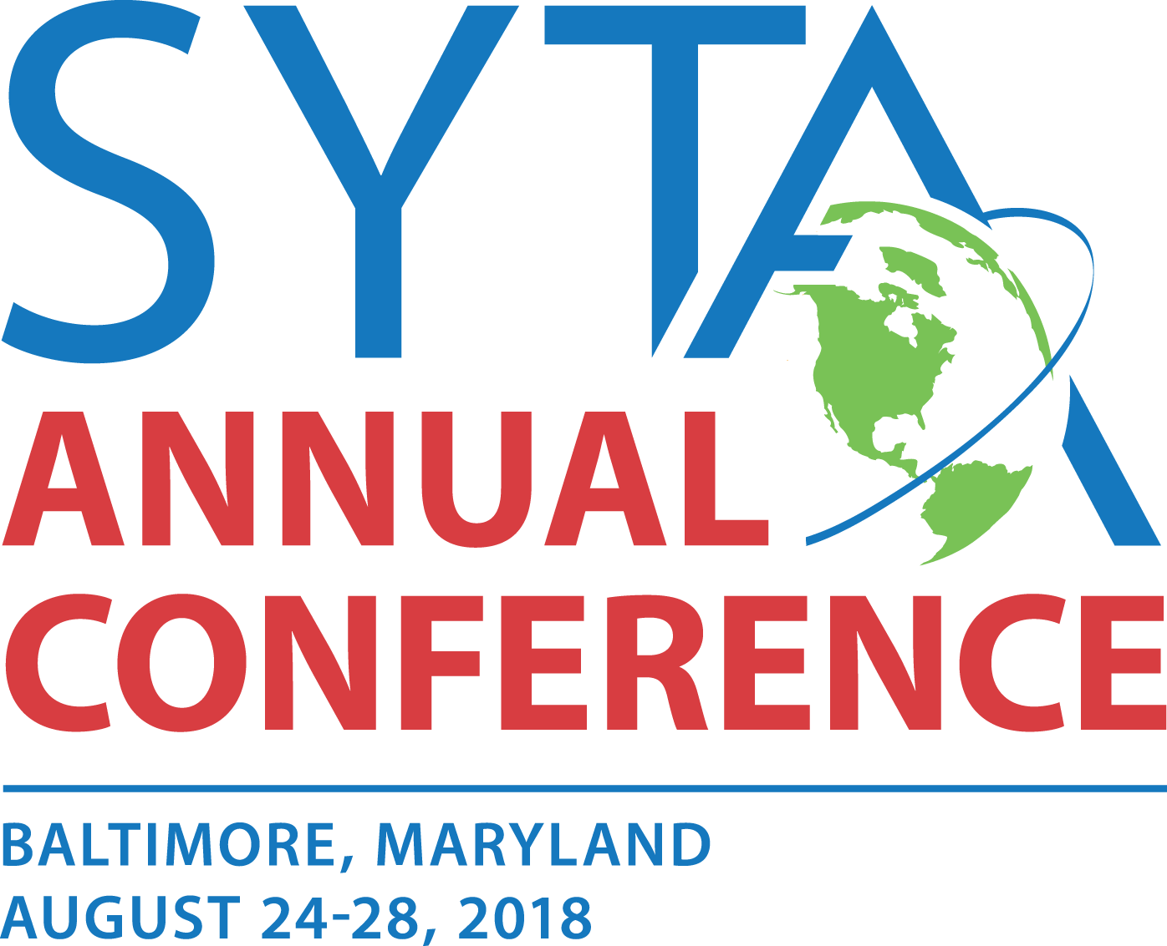
Student Youth Travel Association Emergencies and Safety August 25, 2018
Emergencies and Safety

Slide 2
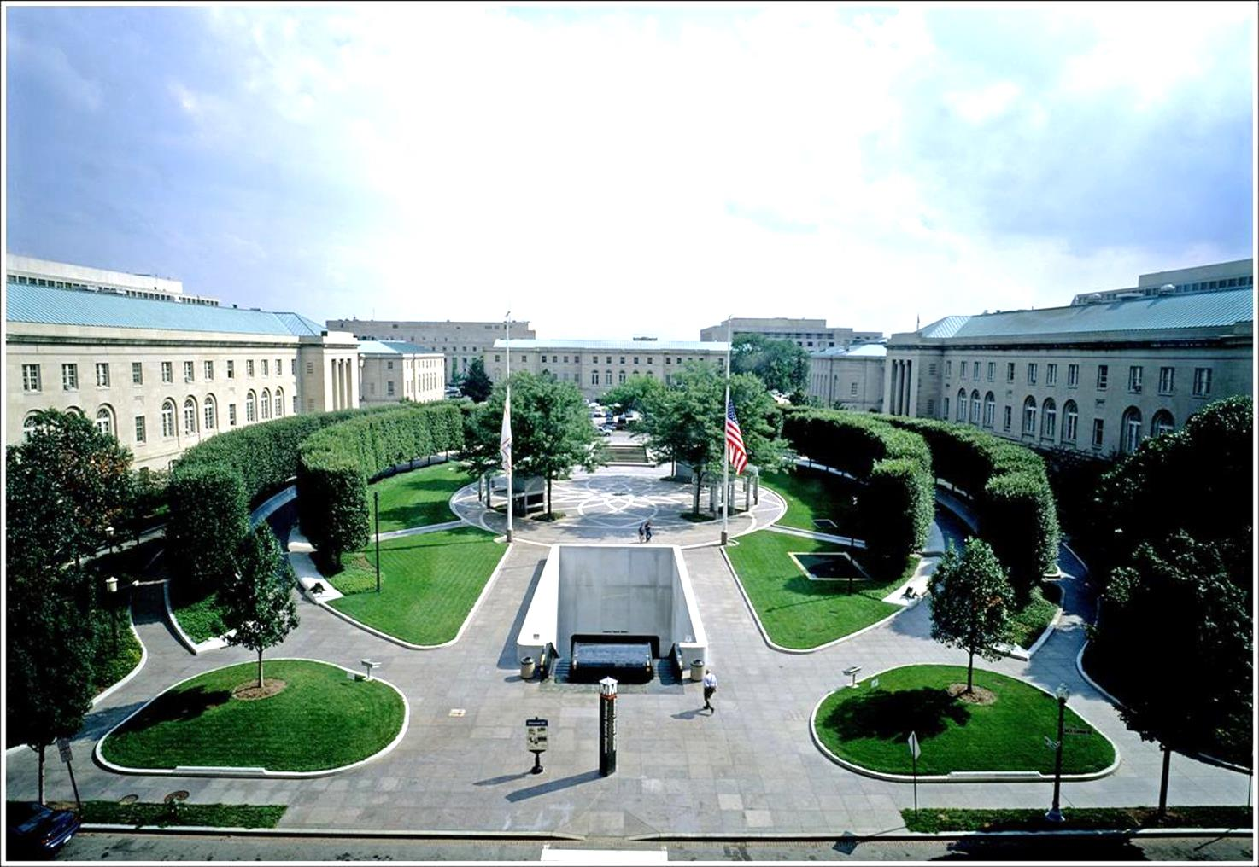
National Law Enforcement Officers Memorial
National Law Enforcement Officers Memorial
400 Block of E Street, NW, Washington, DC

Slide 3
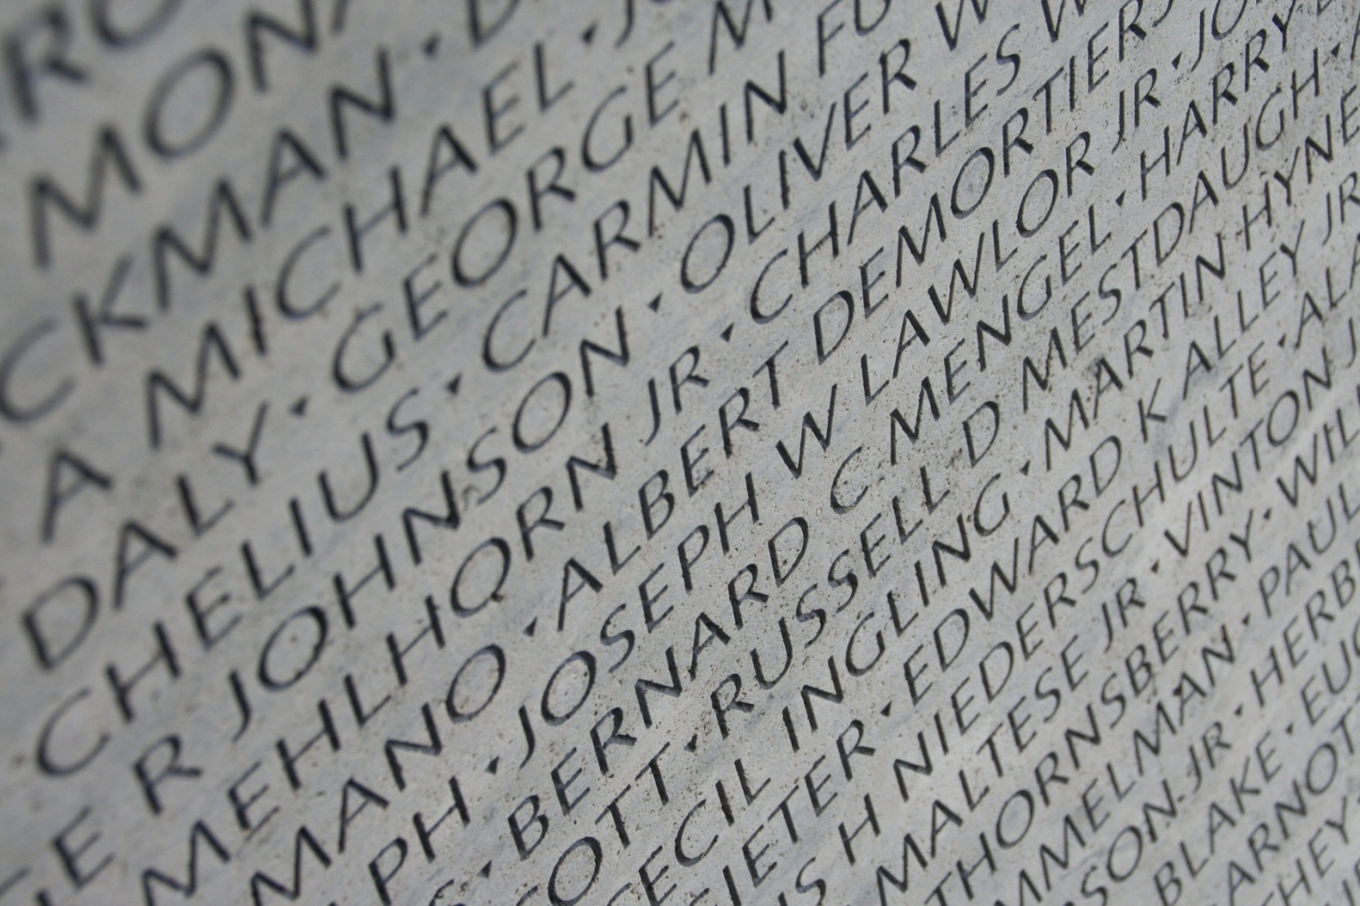

Slide 4
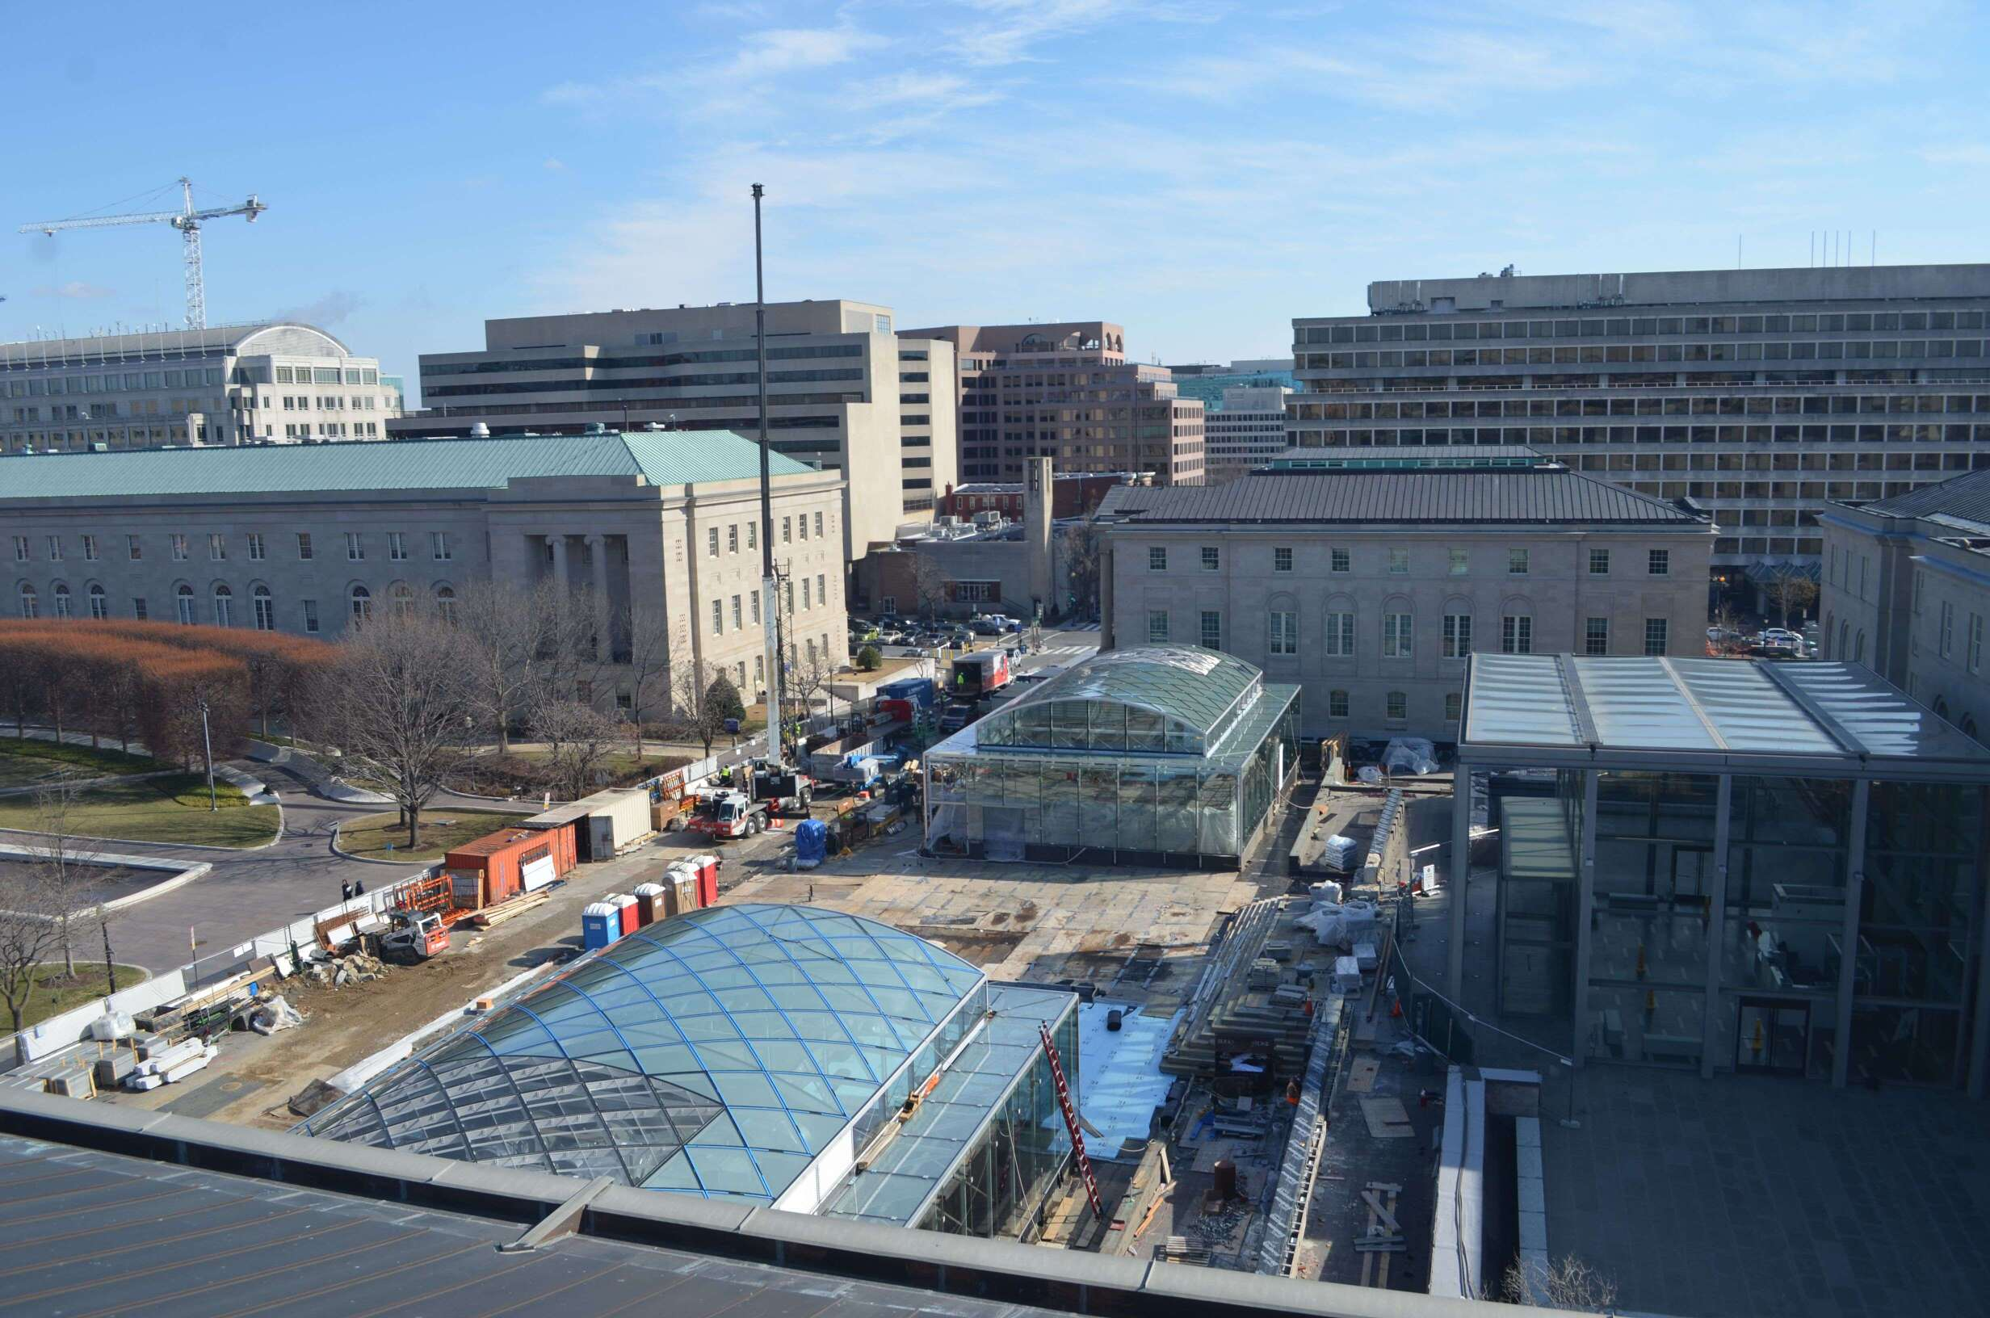

Slide 5
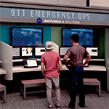
Interactive Exhibits

Slide 6
Museums and National Monuments Have Their Own security

Slide 7
Washington, D.C.
Metropolitan Police
United States Park Police
Metro Transit Police
United States Capitol Police
Uniformed Div. Secret Service
13 other Federal police forces

Slide 8
When Visiting a Museum or Historic Site
Limit bags
Some sites do not allow them.
Check their policy as some fully screen
Mags
X-ray
Wands
Restricted items, such as Selfie sticks
Other restrictions (gum)
Group tour entrances

Slide 9
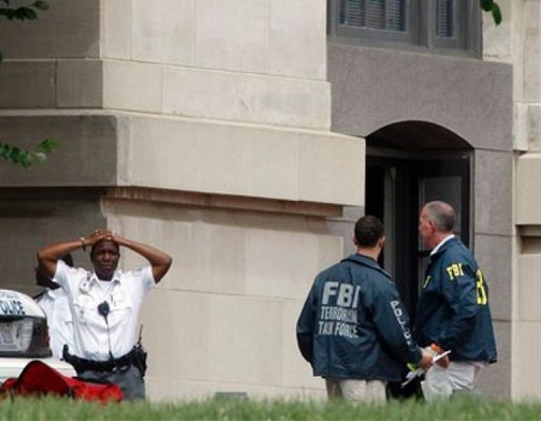
An Example of a Major Incident
Holocaust Museum Shooting
June 10, 2009
Armed guards shoot intruder
Massive Police response
Museum evacuated to rear plaza
Directed away from the immediate threat
MPD Jurisdiction (Fatality) but occurs in USPP Facility
SWAT teams search and EOD sweep the museum
Adjacent buildings go into lock down (U.S. Mint)

Slide 10
Getting Everyone Back Together
Students may be in different spots in a museum
Pre-arranged meeting site
Bus
Evacuation site
Ad Hoc site
Injured (who goes to hospital?)
Witness Statements

Slide 11
Missing Student(s)
Location will determine who begins investigation
Remain at the site
Remain calm/don’t leap
Best possible description
Friends (social media)
Security and Police will broadcast a “lookout”
PA Announcements
No such thing as 24 hours
Ensure students will ask for help and remain in one spot

Slide 12
Other Major Incidents at D.C. Sites
Museums or Historic Sites
White House
Green Paint Lady-National Cathedral
Gyro Copter a the U.S. Capitol
Chase from W.H. to U.S. Capitol with shooting
1998 Shooting at U.S. Capitol
Truck load of dynamite at the Washington Monument
Fence Jumpers
Armed persons
Knife and gun
Plane crash (1990’s)
Helicopter landed (1970’s)
Regular demonstrations
Several suspicious packages and vehicles

Slide 13
Be aware of Demonstrations
Avoid Large Scale Demos
They change direction, and close streets
People can quickly get separated
If arrests are being made, innocent people can get caught in the middle
Counter Demonstrators

Slide 14
What museums and tourist sites routinely handle
Medical Emergencies
Diabetes
Anaphylaxis
Heat related symptoms
Injury
Slip and fall
Lost property/Found Property
Missing or lost persons
Theft and Fraud

Slide 15
Security personnel or museum staff should guide EMS to the patient

Slide 16
What Museums Prepare For

Slide 17
Armed Intruder

Slide 18
Hazardous Materials or Suspicious Packages

Slide 19
Emergency Messaging
PA Systems
Fire Alarms
ADA-beacons with specific alert tones and messaging
Weather
Active Shooter
Other hazards

Slide 20
What is suspicious?
In December, maybe
In July?

Slide 21
Where to get information
Sign up for local information
Weather alerts
Alert DC
www.hesma.dc.gov
Police
Weather
Traffic
Outages
USPPNEWS@usparkpolicepio

Slide 22
Contact Information
For more information:
Nick Breul
Director of Security
National Law Enforcement Museum
(202) 737-7864
nbreul@nleomf.org
www.LawMemorial.org
www.LawEnforcementMuseum.org
38

Slide 23
SYTA Strategic Partners

