Slide 1
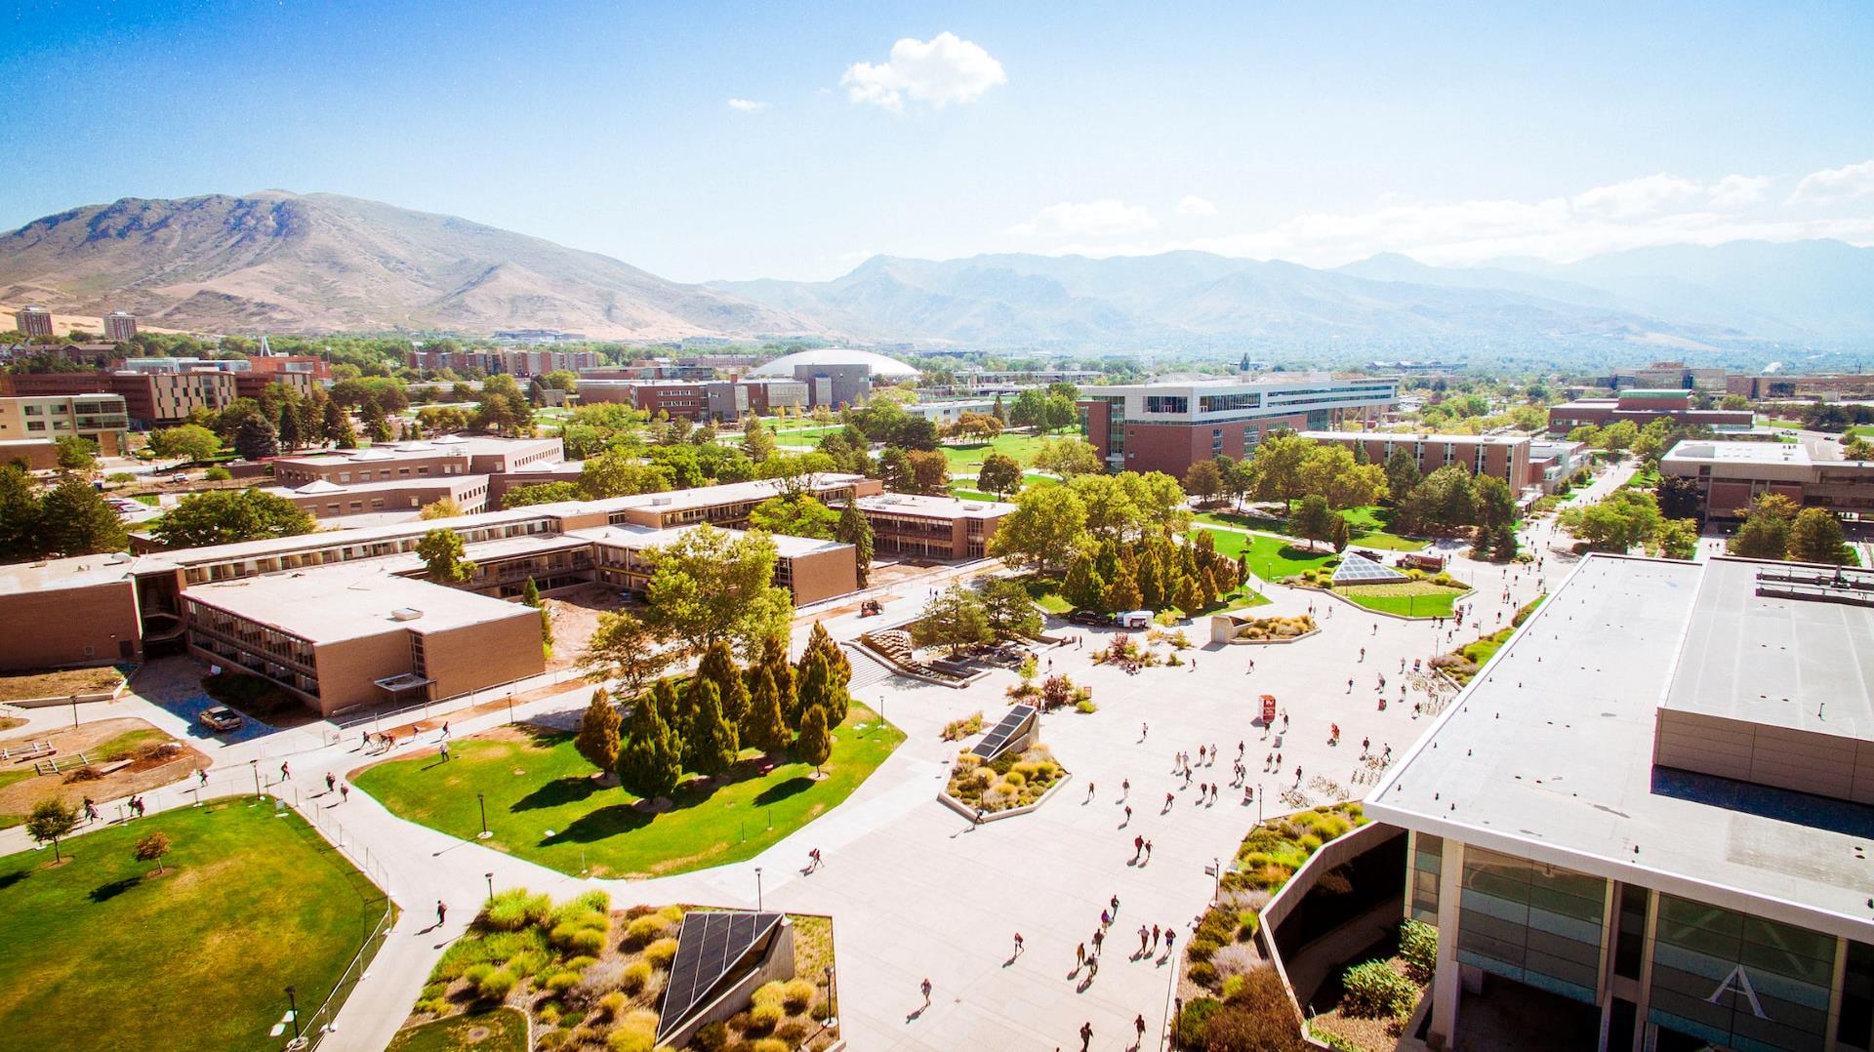


Student Travel Business Barometer 2022
Expertise in Student Travel Research

Slide 2


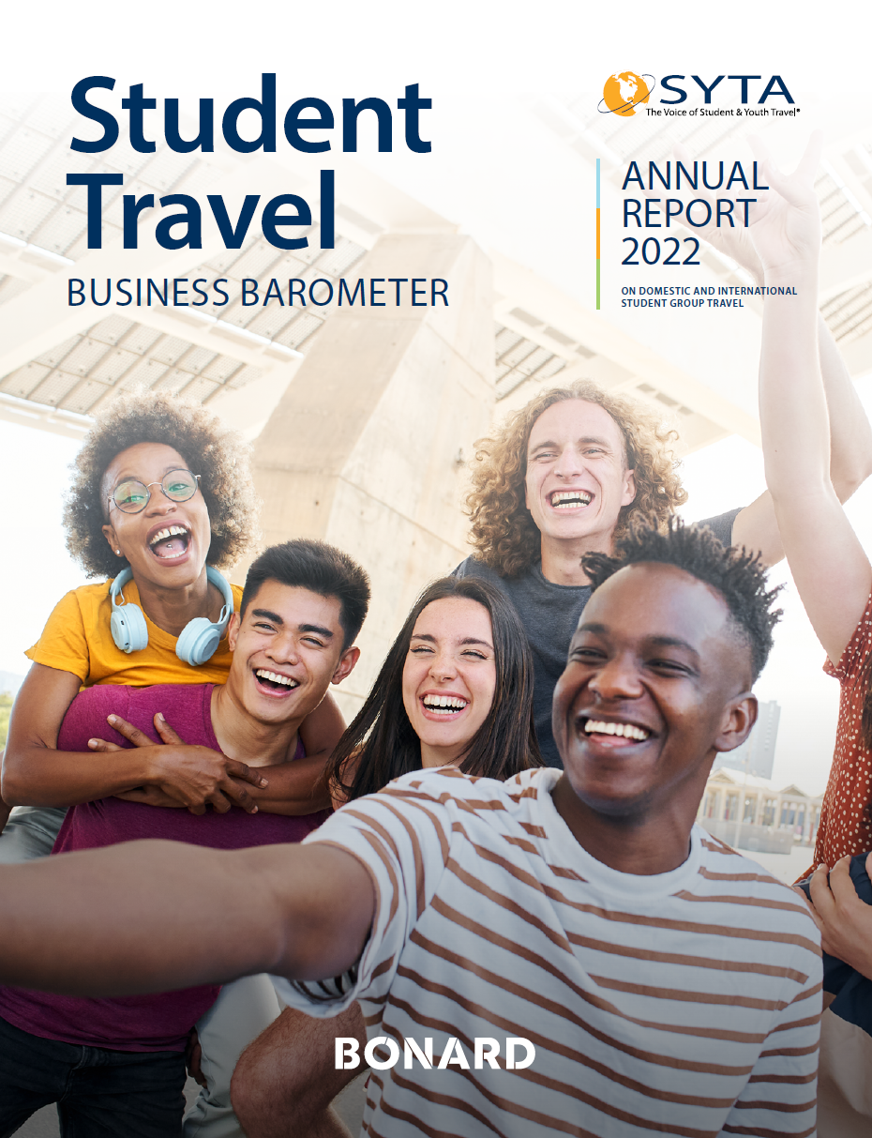
The Barometer aims:
To measure the growth and financial performance of the student group travel market
Provide unbiased evidence of the size and impact of student travel on a global basis to assist in government advocacy
Establish benchmarks for measuring growth year over year
Identify patterns in domestic and international youth travel
Assist tour operators and their supplier and destination partners to forecast future business
Identify trends that affect youth travel
Bring reliable and consistent business intelligence to international student tour operators
Key features
4th
140
22
Edition
Student tour operators
Countries represented

Slide 3
STUDENT TRAVEL BUSINESS BAROMETER 2022 CONTAINS:
Number of student taking trips in-country and out-of-country
Market recovery levels and forecast
Students’ travel plans and trip parameters
Changes in the trip price
Trip funding
Country profiles
Transportation
DEFINITIONS:
Student group travel: tours composed of at least two people aged 10–18, traveling out of their day-to-day environment on the same dates and following the same itinerary.
In-country travel refers to any trip conducted within the students’ own country.
Out-of-country travel refers to any trip which includes traveling from one country to another.

Slide 4



Market Overview
Overall student volume: In-country and Out-of-country
930K
Year-on-year comparison
414K
Overall, the sector recovered to
44%
of its 2019 student volume in 2022
+266%
113K
Source: SYTA & BONARD, 2023, n=140
Notes:
Like to sample accurate trendy +

Slide 5
Market Overview
Overall student volume: USA
2021 vs 2022
+330%
Year-on-year comparison
The USA recovered to 67%
of the 2019 student volume
Source: SYTA & BONARD, 2023, n=86

Slide 6
Market Overview
Overall student volume: Rest of the World
2021 vs 2022
+275%
Year-on-year comparison
Rest of the World recovered to
22%
of the 2019 student volume
Source: SYTA & BONARD, 2023, n=54

Slide 7

In-country travel

Slide 8
In-country Trip Parameters
In-country trip parameters: 2019 to 2022
The average trip duration in 2022 was 5.9 days, slightly longer than in 2019 (5.1 days).
Average trip duration
Average group size
6 days
67 students
5.1 days
65 students
5.9 days
56 students
52 students
In 2022, the average student group size was 65 students - higher than in 2019 and 2021 (56 and 52 students respectively).
3.8 days
Source: SYTA & BONARD, 2023

Slide 9
In-country Travel Plans
Change in customers’ in-country travel plans: 2021 and 2022
Sixty-five percent of student groups
traveled in-country in 2022, which is
a considerable improvement from
16% in 2021.
Only 13% of in-country trips were canceled, compared to
32% in 2021.
Source: SYTA & BONARD, 2023

Slide 10
In-country Trip Price
Change in the in-country trip price: 2019 vs 2022
Overall, the majority of tour operators saw an increase in trip price of over 10%:
  10-15% on accommodation
  More than 15% on transportation
  5-10% for meals and attractions
  Insurance fees remained largely stable.
Source: SYTA & BONARD, 2023

Slide 11
Market Recovery: In-country Travel
Future bookings as a % of 2019 booking volume
47% OF RESPONDENTS EXPECT TO
REACH MORE THAN 80%
OF 2019
BOOKING VOLUME BY
62% OF RESPONDENTS EXPECT TO
REACH MORE THAN 80%
OF 2019
BOOKING VOLUME BY
66% OF RESPONDENTS EXPECT TO
REACH MORE THAN 80%
OF 2019
BOOKING VOLUME BY
2023
2024
2025
Source: SYTA & BONARD, 2023

Slide 12
Out-of-country travel

Slide 13
Out-of-country Trip Parameters
Out-of-country trip parameters: 2019 to 2022
The average trip duration
was lower than in 2021 – 9.7 days – but higher than
8.1 days in 2019.
Given the increase in transportation prices, groups opted to travel for longer.
The average group size was 25, compared to 32 in 2019, which was the smallest group size reported in the last
four years.
Average trip duration
Average group size
10.5 days
36 students
9.7 days
25 students
8.1 days
32 students
27 students
7.3 days
Source: SYTA & BONARD, 2023

Slide 14
Out-of-country Travel Plans
Change in customers’ out-of-country travel plans: 2021 and 2022
In 2022, 57% of out-of-country trips took place as scheduled, compared to a mere 9% in 2021.
10% of trips were canceled, which
is a notable decrease from the 33%
cancelation rate observed in 2021.
Source: SYTA & BONARD, 2023

Slide 15
Out-of-country Trip Price
Change in the out-of-country trip price: 2019 vs 2022
Overall, the majority of tour operators saw an increase in trip price:
  10-15% on accommodation
  More than 15% on transportation
  5-10% for meals and attractions
  5-15% for insurance fees.
Source: SYTA & BONARD, 2023

Slide 16
Market Recovery: Out-of-country Travel
Future bookings as a % of 2019 booking volume
38% OF RESPONDENTS EXPECT TO
REACH MORE THAN 80%
OF 2019
BOOKING VOLUME BY
52% OF RESPONDENTS EXPECT TO
REACH MORE THAN 80%
OF 2019
BOOKING VOLUME BY
70% OF RESPONDENTS EXPECT TO
REACH MORE THAN 80%
OF 2019
BOOKING VOLUME BY
2023
2024
2025
Source: SYTA & BONARD, 2023

Slide 17
Out-of-country Travel Destination preference
Share of customer traveling to top 5 destinations
EUROPE-BASED
TOUR OPERATORS
CANADA-BASED
TOUR OPERATORS
U.S.-BASED
TOUR OPERATORS
Among U.S.-based tour operators, 21% of customers opted to travel to the UK, while the figure for Europe-based tour operators was 52%.
Source: SYTA & BONARD, 2023

Slide 18
Country profiles

Slide 19
Country profile: USA
Trip parameters
In-country
Out-of-country
Student numbers in 2022 reached an impressive 76% of the volumes seen in 2019.
Over 308,000 students traveled within the USA in 2022, surpassing the industry expectation of around 243,500 students.
Compared to
2021, student numbers were up by
a remarkable 330%.
Average trip duration
Average trip duration
6.2 days
9.7 days
9.7 days
5.9 days
3.9 days
7.5 days
Average group size
Average group size
72 students
65 students
44 students
48 students
32 students
25 students
Source: SYTA & BONARD, 2023

Slide 20
Country profile: USA
Share of customers who traveled to the following destinations
20%
Orlando
Philadelphia
4%
20%
Washington, D.C.
Boston
3%
New York
15%
Chicago
3%
Los Angeles
6%
Gettysburg
3%
5%
Seattle
3%
Williamsburg
Source: SYTA & BONARD, 2023

Slide 21
Country profile: Canada
Trip parameters
In-country
Out-of-country
The in-country travel sector in Canada recovered about 14% of its pre-pandemic student numbers in
2022.
Nonetheless, the data still indicates a significant recovery in the industry,
with student numbers growing by an impressive 4,190% between 2021
and 2022.
Average trip duration
Average trip duration
10.5 days
5 days
8.3 days
3.7 days
3.2 days
6.4 days
Average group size
Average group size
62 students
72 students
34 students
27 students
25 students
40 students
Source: SYTA & BONARD, 2023

Slide 22
Country profile: Australia
Trip parameters
In-country
Out-of-country
In 2022, developments in Australia were still significantly impacted by the border closure in 2020 and 2021.
Consequently, student group travel reached only approximately 50% of its pre-pandemic volume.
The expectations for
2023 are optimistic, with operators projecting a substantial increase to
20,100 students (12,400 in 2022).
Average trip duration
Average trip duration
5.5 days
9.1 days
2022
2022
Average group size
Average group size
65 students
24 students
2022
2022
Source: SYTA & BONARD, 2023

Slide 23
Transportation

Slide 24
Transportation
Participants responses
Do you work with a third party ground operator
who books motorcoaches for your groups?
Do your student groups ask that you use a motorcoach company from their preferred vendor list?
Yes
No
Do you book motorcoaches that will drive through the
night for overnight trips?
Maybe
Do your student groups request motorcoaches with seat belts?
Source: SYTA & BONARD, 2023

Slide 25
Transportation
Participants responses
Do your student groups ask that drivers be vaccinated or wear a mask?
Do your student groups ask if the motorcoach company has
a sustainability or green policy?
Yes
No
Do you book motorcoaches for day trips?
Maybe
Source: SYTA & BONARD, 2023

Slide 26


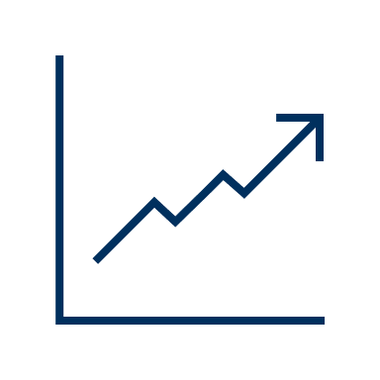
Key highlights for 2022:
The number of students traveling in 2022 exceeded tour operators’ expectations.
Tour operators expected 295,000 to travel in-country in 2022, however more than 350,000 students actually traveled.
In-country trips accounted for 54% of the 2019 student volume, whereas out-of-country trips recorded 22% of the 2019 student volume.
The recovery of in-country student volume was predominately driven by the USA, which
in 2022 reached 67% of the 2019 student volume.
Tour operators saw a price increase across all trip cost components.
Rise in transportation costs drove the increase in trip prices in 2022, with nearly half of respondents reporting bus, train and air transportation increases of more than 15%.

Slide 27
THANK YOU
TO ALL STUDENT TRAVEL BUSINESS BAROMETER PARTICIPANTS.
For more information about the Barometer, please contact research@syta.org.

