Slide 1
Safety Preparedness Webinar
March 16, 2023
SYTA Health & Safety Team

Slide 2

Agenda
Crisis Coordination Team
Go Team
Family Liaison
Communications
Call Handling
Product Delivery
Legal/Executive
IT
Red Card/Escalation Matrix
Crisis Simulation
CSTO
Q&A

Slide 3
Crisis Coordination Team
Team Objective:
Ensure well-being of the victims, participants not directly affected by incident, families, and staff by leading the crisis response. Communicate with all Crisis Response Team Leads, updating them regularly on any new information. Document all activities and assign action item to each team.

Slide 4
Go Team
Team Objective:
Ensure well-being of the victims, participants not directly affected by incident, families and staff by traveling to the emergency site ASAP. Communicate and coordinate with school/university representatives (superintendent, principal, university contacts, etc.) on next steps.
Liaise with On Site personnel and the Family Liaison Team on how and when emergency contacts are being notified. Contact local officials and liaise with them. Document all activities and relay back to Crisis Response Team leads as regularly as possible.

Slide 5
Family Liaison
Team Objective:
Liaise with family members of participants as well as schools/university contacts making sure they are informed and kept up to date as issues surrounding the emergency at hand unfold. Liaise with Go Team and the Crisis Coordination Team for onsite status updates. Encourage family members to limit calls to your organization and appoint one contact person per family when possible.

Slide 6
Communications
Team Objective:
Provide excellent customer service, both internally and externally, by preparing messaging and scripts for Family Liaison & Call Handing teams. Handle media relations, internal communications and web updates.

Slide 7
Call Handling
Team Objective:
Provide excellent customer service by answering all incoming calls to main phone line and dealing with all general inquiries relating to the incident. Answer business-as-usual calls that are non-incident related, addressing issues for upcoming programs and reassuring participants.

Slide 8
Product Delivery Team
Team Objective:
Coordinate and communicate with all vendors impacted by the incident. Help facilitate the well-being of the victims, participants not directly affected by incident, families, and staff by organizing transportation to, and from, accommodations at the crisis site. Liaise with Go Team and other Crisis Response Team Leads to take care of any operational and flight issues. Manage all itinerary components for upcoming programs that might be affected by the incident.

Slide 9
Legal/Executive
Team Objective:
Provide legal assistance and review of outgoing information related to the incident. Serve as primary communicators with board members. Manage insurance issues and financial controls related to the incident.

Slide 10
IT
Team Objective:
Ensure that Crisis Response Teams receive needed IT related assistance.

Slide 11
Red Card
Objective:
As the first person to receive the call about the incident, your goal is to obtain as much information as possible. Use the Red Card form to collect information.

Slide 12
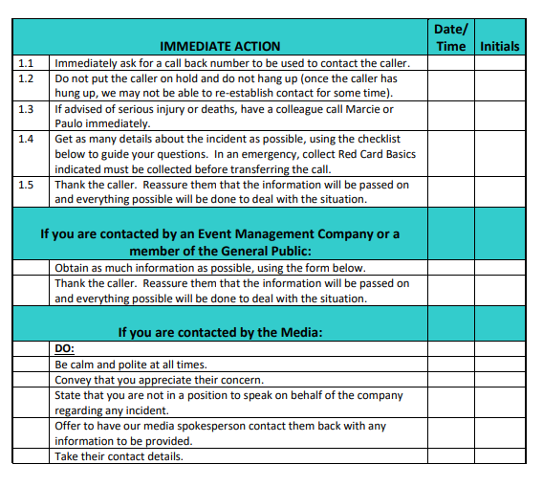

Slide 13
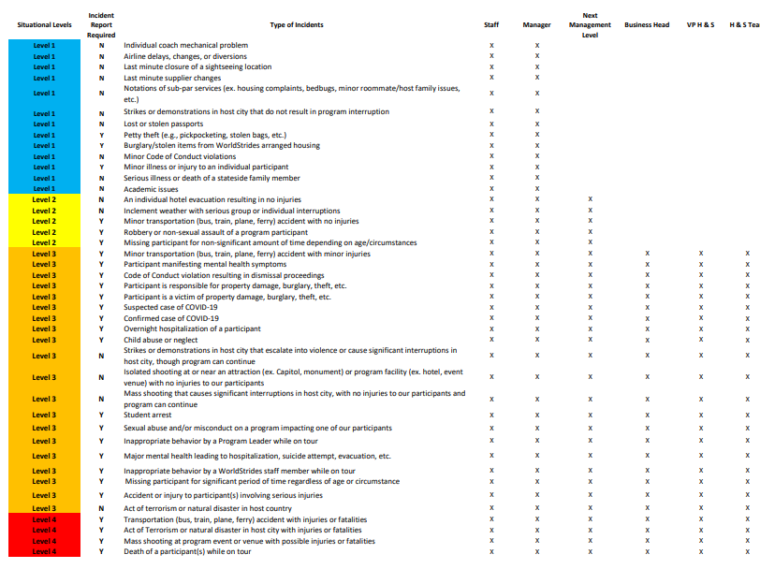

Slide 14
Crisis Simulation
Objective:
To be able to demonstrate the processes to be exercised with a crisis occurs. All team members that are part of a crisis team must be involved in the simulation.

Slide 15

Objective:
To educate the student & youth travel industry on the administration of safety and risk management standards for student & youth travel.
Risk Assessment and Management Emergency Response
Crisis Communications Staff/Chaperone/Driver Background Checks Business Practices
Vendor Assessments Safety Procedures/Briefings
ADA Requirements Family Assistance & Support
Health Information Swimming Safety
International Travel Requirements First Aid/CPR Training
Incident Response/Lost Student Protocols Security

Slide 16
Questions?

